Slide 1
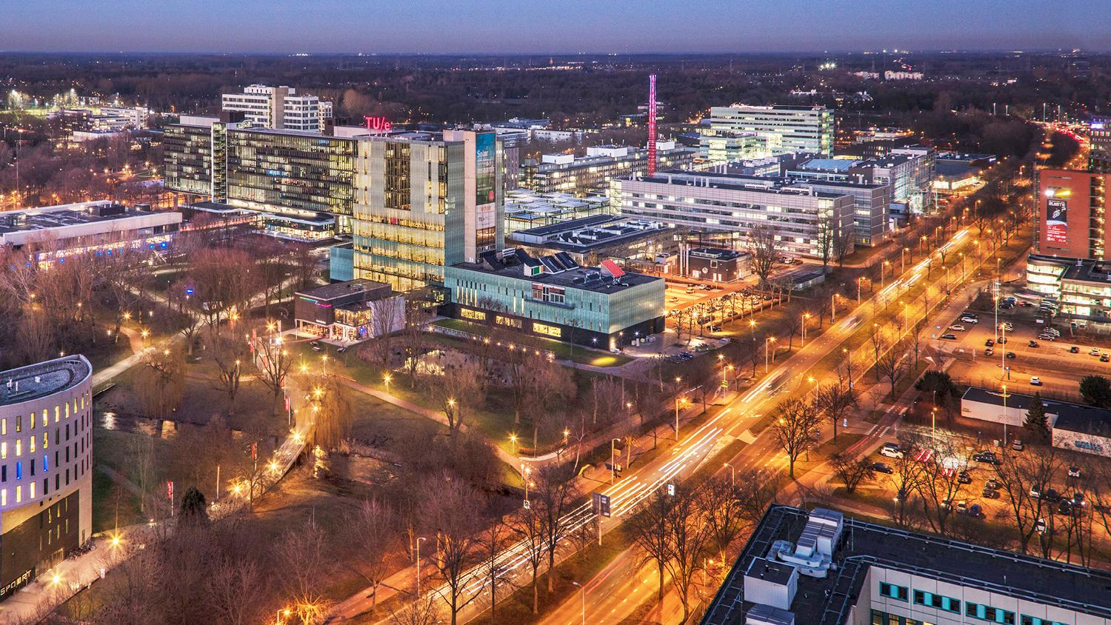
OpenML Deep Learning Extension
05/07/2019
A.Danila, B.Enache, G.Goncheva, L.A.Hijl, A.Mares, V.Minev, T.Nguyen, A.L.L.Nijhuis, C.T. Nohai, D.M.Serban, T.Zahariev, S.Zarkova
OpenML Support Squad

Slide 2
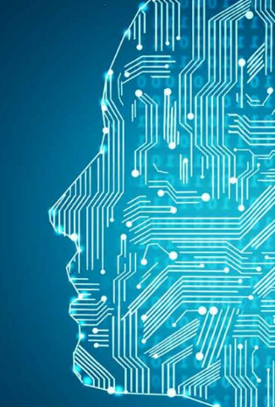





Overview
Artificial Intelligence
Deep Learning
OpenML
DL Extension Library
Visualization
Documentation
Demo

Slide 3
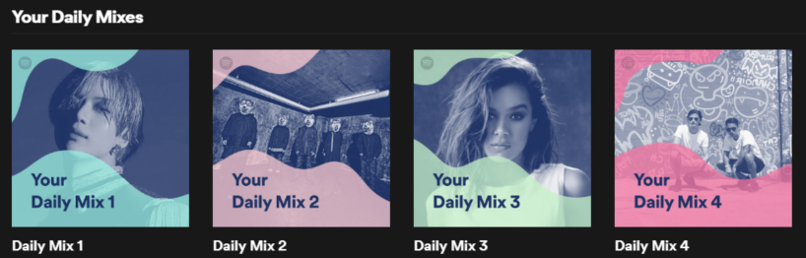
Artificial Intelligence
“The theory and development of computer systems able to perform tasks normally requiring human intelligence, such as visual perception, speech recognition, decision-making, and translation between languages.” [1]
Machine Learning is a subset of AI
Widely used (ex. Spotify, Netflix, Self-driving cars)

Slide 4

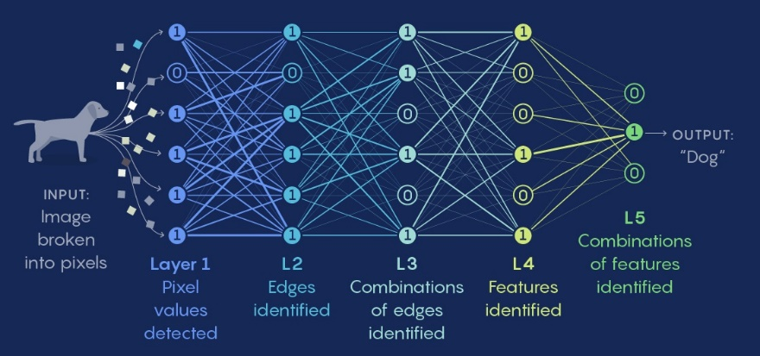
Deep Learning
Subset of Machine Learning
Based on Biology – Brain
Neural Networks
Example: Image Recognition

Slide 5
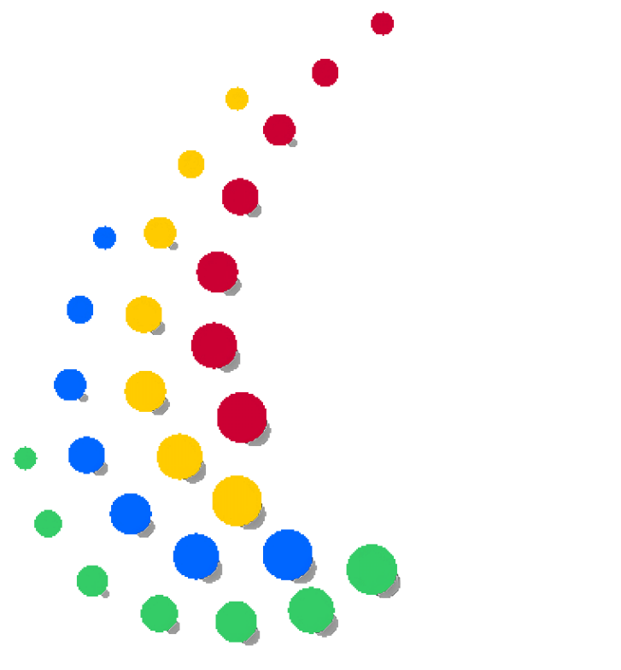




OpenML
Platform for Data Scientists
Sharing
Compare results
Integrated with biggest machine learning libraries.
Problem:
No support for Deep Learning Libraries
No Visualization of structure and learning curve

Slide 6

Our Solution (1): DL Extension Library

Slide 7
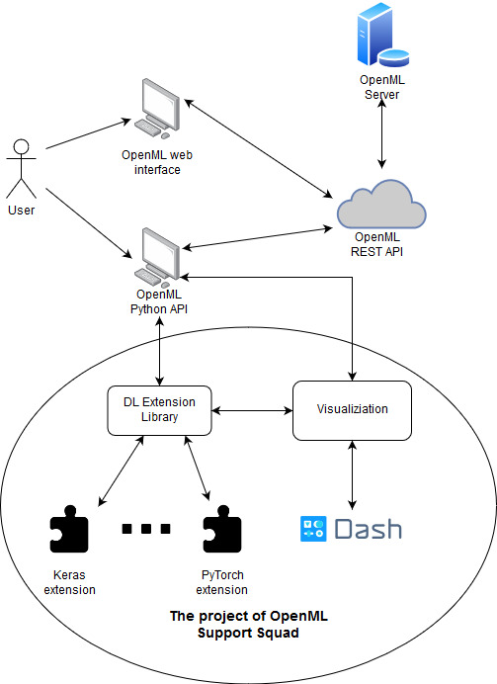
Our project (1): DL Extension Library
Currently only Sklearn is supported
Provide ability to upload deep learning models using some of the biggest deep learning libraries
Classification and Regression tasks
Extend each library separately
Deep learning specification
Created 4 extensions
Implement interface from OpenML
Keep architecture - Maintainability

Slide 8

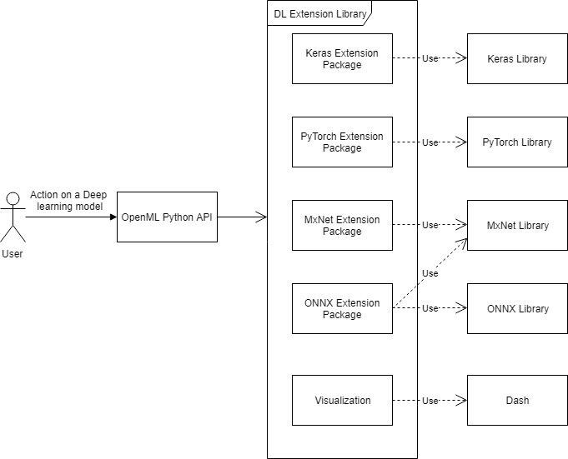




Implementation
- High level, Important to client
- Low level, Tensors, Manual
- Blocks, also used for ONNX
- Specification, more compatibility
Implement “Extension” interface
Serialize
Deserialize
Run
Additional (Is Flow, Get Version Info)

Slide 9
Our Solution (2): Visualization

Slide 10

Our project (2): Visualization Module
Separate from DL Extension Library
Used as a prototype which can be implemented
Uses
Used to visualize model structure and performance

Slide 11
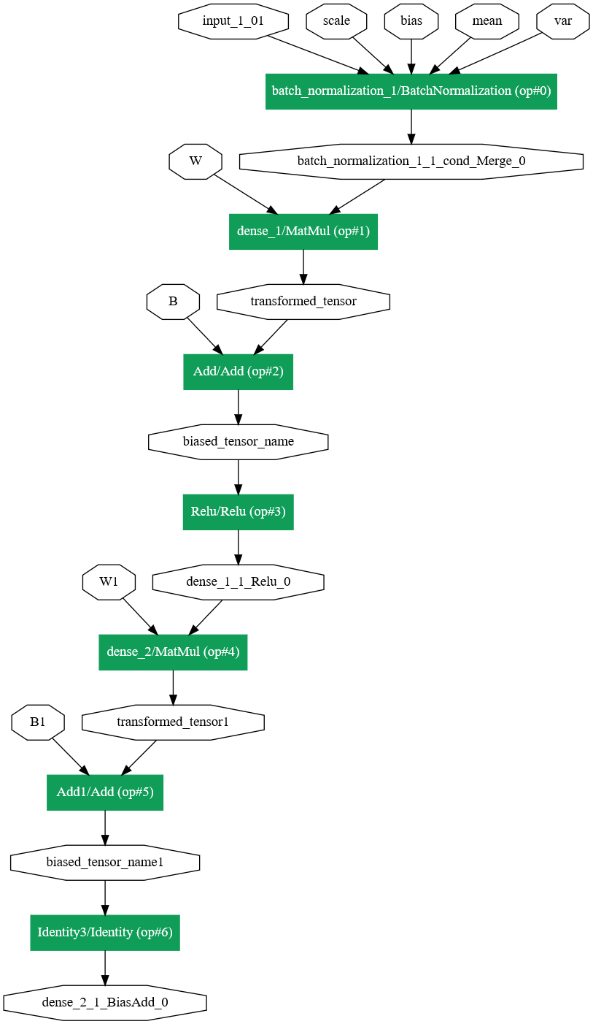
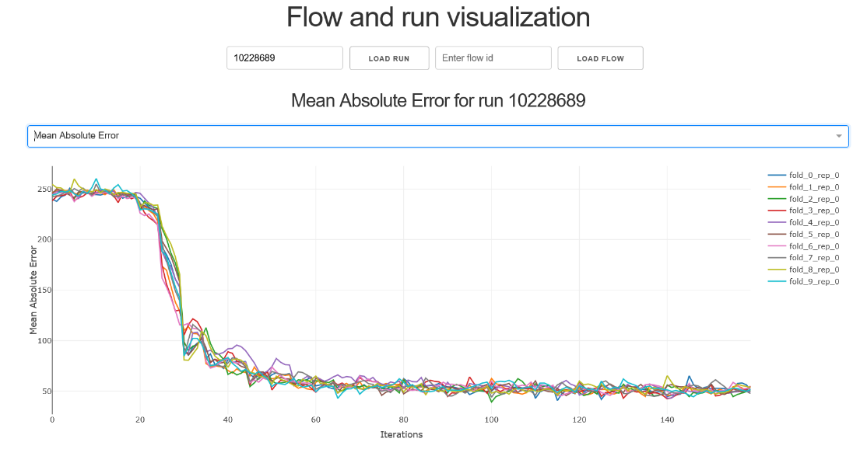
Our project (2): Visualization Module
Left: Model Structure
Bottom: Performance Metrics

Slide 12
Implementation
Separate from other functionality
Still little freedom for architecture because of dash
Visualize performance metrics
Visualize model structure – using ONNX

Slide 13
Documentation

Slide 14


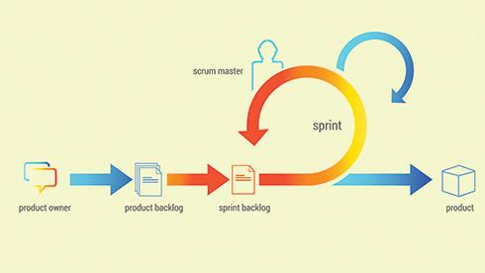
Documentation
Scrum
Requirements Documents
Testing Documents
Architectural Document, User Manual, Transfer Document

Slide 15
Demo

Slide 16
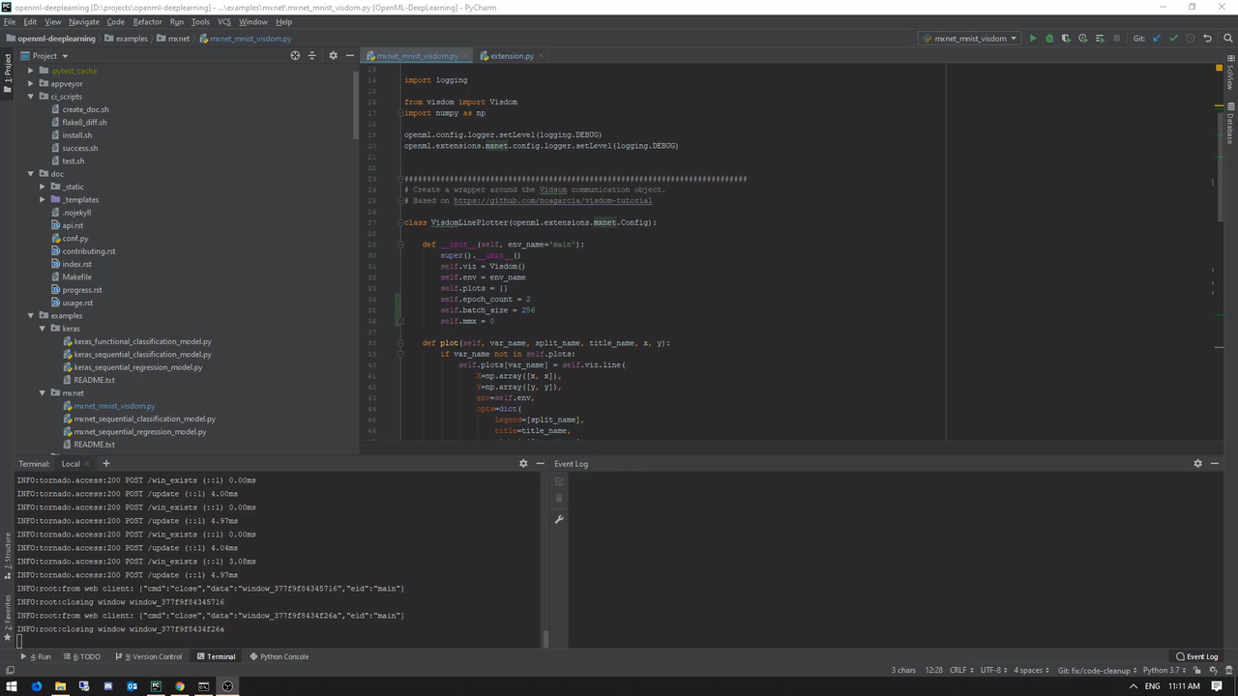

Slide 17
Questions?

